Slide 1
Culture Jamming
Culture jamming (also called “Subtervising”) is a form of protest that uses rhetorical savvy to draw attention to the faults of social institutions or to their ways of controlling consumers. Culture jammers are inspired by the critical theory of the Frankfurt School, which described the power of mass media and advertising to shape society’s norms, values, and behavior through the power of subliminal messaging. Activist interventions may take the form of memes, graffiti, stickers, or public performances.

Slide 2
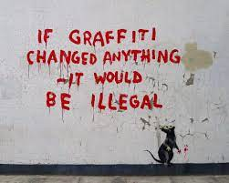

Slide 8
